Slide 1

JsDiffer: Refactoring Detection in JavaScript
Presented By
Mosabbir Khan Shiblu
k_mosabb@encs.concordia.ca
Supervised By
Dr. Nikolaos Tsantalis
nikolaos.tsantalis@concordia.ca
Date: 2022-11-03
Notes:
Hi Everyone,
My name is Mosabbir and today I am going to present my work JsDiffer which is a refactoring detection tool in JavaScript.

Slide 2
Introduction
Refactoring:
Any changes in source code that improves its understandability or maintainability.
Example:
- Renaming a Variable.
- Extracting some code from one Function to a new Function.
- Moving a Function to another File.
Notes:
So, what is Refactoring? This basically means any changes in source code to improve its maintainability
- Some common refactorings that we perform on daily basis are renaming a variable, extracting code from a large function to a new function, moving or renaming a file

Slide 3
Motivation
Understand software evolution.
Merge conflicts resolving.
Automatic commit message.
Enhance plagiarism detection tools.
Re-perform changes in different contexts*.
* Quinten David Soetens, Romain Robbes, and Serge Demeyer. Changes as first-class citizens: A research perspective on modern software tooling. 2017.
Notes:
So why do we need a refactoring detection tool for JavaScript?
Researchers can better Understand software evolution by tracking code elements
It can accelerate code review process by pre-matching refactored elements
Moreover, we can auto append refactorings information in commit message to give heads up to the code reviewer.
On the other hand, accuracy of source code plagiarism detection tools can potentially be improved
Lastly, IF some common pattern of refactoring can be extracted, they can re-performed in different contexts*

Slide 4
Background
Over 3,000 papers on refactoring topics*
Detection Methodologies
Meta Data (e.g., searching for "refactor" in commit message**)
IDE Activity Tracking (e.g., Analyzing the usage of Refactoring Commands in Eclipse IDE***)
Modern Tools use Static Source Code Analysis by taking the changed files of a commit.
* Chaima Abid, Vahid Alizadeh, Marouane Kessentini, Thiago do Nascimento Ferreira, and Danny Dig. 30 years of software refactoring research: a systematic literature review. 2020.
** Jacek Ratzinger, Thomas Sigmund, and Harald C Gall. On the relation of refactorings and software defect prediction. 2008.
*** Emerson Murphy-Hill, Chris Parnin, and Andrew P. Black. How we refactor, and how we know it. IEEE Transactions on Software Engineering, 38(1):5–18, 2012.
Notes:
Now I will talk about existing works on refactorings
- The literature on refactoring is rich
- It’s a well-established growing research topic with over 3000 existing papers
- However, We can generalize the detection methodologies into 3 sections
- Some tools found refactoring by searching for keywords related to refactoring in commit message
- Other researchers used the history of applied refactorings in an IDE such as eclipse
- However, all the current state of the arts use Static source code analysis by comparing only the modified, added or removed files in a commit.

Slide 5
Modern Refactoring Detection Tools
RefactoringMiner 2.0*
Matches statements that could be texturally different
Supports Java
Current state of the Art
Precision 99.6% and Recall 94%
RefDiff 2.0**
Detection Works on based on the Textual Similarity of Tokens inside of Classes, Functions and Files.
The First MultiLanguage Tool. Supports Java, C & JavaScript
Only tool that supports JavaScript
JS Precision 91% and recall 88%
RefDetect***
Program is represented as a sequence of characters and detection is done by a threshold-based String Alignment Algorithm.
Supports Java and C++.
Java Precision 91.2% and recall 84.5%
* Nikolaos Tsantalis, Ameya Ketkar, and Danny Dig. Refactoringminer 2.0. 2020.
** Danilo Silva, João Silva, Gustavo Jansen De Souza Santos, Ricardo Terra, and Marco Tulio O. Valente. Refdiff 2.0: A multi-language refactoring detection tool. 2020.
*** Iman Hemati Moghadam, Mel Ó Cinnéide, Faezeh Zarepour, and Mohamad Aref Jahanmir. Refdetect: A multi-language refactoring detection tool based on string alignment. 2021.
Notes:
- Now I will briefly discuss 3 state of the art detection tools
- First is Refactoring miner 2.0 which is the only tool capable of detecting refactorings on variable or statement level. For example, rename variable.
- It also has the highest precision close to 100% and at the same time very good recall of 94%
- It structurally matches elements in statement level and can match code that are signicantly textually different
- Next we have refDiff 2.0 which measures the similarity of tokens inside container elements
- It is the first multi language tool and supports java C and only tool that supports JavaScript
- It has a precision and recall of around 90%
- The last and newest of them is RefDetect.
- It represents programs as a sequence of characters and detection is done by String Alignment Algorithm named FOGSSA
- IT supports Java and C++
Since RefactoringMiner does not support JS, but it's the current state of the art detection tool therefore our goal is to take inspirion from this tool and apply it in JavaScript

Slide 6
Limitation of Existing Approaches
Only one tool supports JavaScript (RefDiff 2.0)
Cannot detect variable level refactorings (Except RefactoringMiner 2.0)
Textual similarity-based threshold (Except RefactoringMiner 2.0)
RefDiff 2.0 represents container elements such as Functions, Classes, or Files as bags of tokens. Therefore, it cannot detect variable-level refactorings.
Notes:
Now I am going to discuss some of the limitations of existing approaches
- Almost all the existing tools are Java Based
- Cannot detecting refactorings lower than container level
- They have some sort similarity textual threshold which cannot be applied universally
- RefDiff 2.0 which is the only tool that supports JavaScript preserves .
However, it represents containers as bag of tokens and do not have their structural location information, Therefore by DESIGN it cannot detect changes lower than container/ function level.
On the other hand, RefactoringMiner only supports Java

Slide 7
JsDiffer
Inspired by RefactoringMiner 2.0
Can detect variable level refactorings such as Rename Variable, Rename Parameter etc.
Has a Precision of 96% and a recall of 44% when studied on an oracle of 341 JavaScript refactoring instances.
Notes:
- This leads to the origination of our tool JsDiffer
- which uses similar statement matching algorithm of RefactoringMiner 2.0 to detect variable level refactorings in JavaScript
- JsDiffer archived a precision of 96% and a recall of 44% when studied on an oracle of around 350 JavaScript refactoring instances

Slide 8
Contribution
1. First tool to detect variable level refactorings between two JavaScript source codes
2. Supports 18 refactoring types
3. Supports detection of Change Variable Kind refactoring which is the first JavaScript-specific refactoring detection
4. Provided a well-validated public Oracle of 341 JavaScript refactorings
Notes:
Our main contributions are -

Slide 9
Detection Process
2 Sets of Source File Contents
Containers with
Composite Statements
Outputs
Refactorings,
Matched & Unmatched Elements
Model
Diff
Input can be from any two code snippets, files, a commit, directories etc.
Files, Functions, Classes can have statements (leaf or Composite) or other container declarations)
Diffing approach is very similar to RefactoringMiner
Notes:
Here is a brief overview how our tool works on a high level/
- JsDiffer takes any two programs which can come from commit, file or directories and then model them as composite pattern where
- Container elements such as function, class, or file can contain statements or another container
- For each leaf statement we also preserve all the variables, literals, Method invocation and basically anything that appears in that statement
- Then The diff phase basically matches elements and some of the differences help us identify refactorings
Now I am going to focus on the diff part particularly how the statements are matched

Slide 10
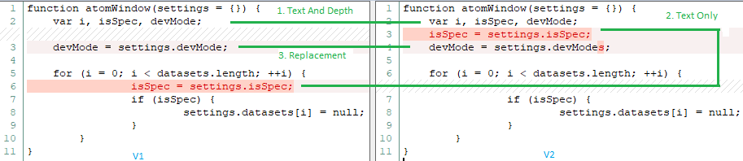
Diffing Methodology – Statement Matching
Round Based (Similar to RefactoringMiner)
1. Textually identical in Same Depth
2. Textually Identical in different depth
3. Syntax aware replacement and heuristics to match textually different statement
For multiple matches, best match is taken based on position, textual differences etc.
Notes:
The Heart of our algorithm is statement matching.
We employ a very similar approach of RefactoringMiner by matching them in various rounds
Here is an example of statement matching between the source code in v1 and v2
- So first round line 2 of both functions are matched because they are the first statement and textually identical
Then line 6 is matched with line 3 in version 2 because they are textually identical but in a different depth
Line 3 is textually not identical as you can see on version 2 the devMode become devmodes.
This is matched by performing replacing the unmatched identifier in version 1 in a systematic way.

Slide 11
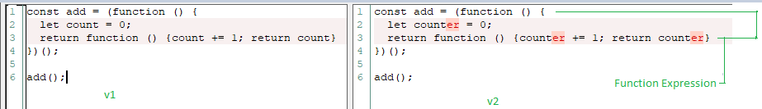
Differences in Java and JavaScript code
Problem: Function Expression
Solution: First Match FEs in rounds
Code snippet is from https://www.w3schools.com/js/js_function_closures.asp
Notes:
Now I am going to discuss what major changes and considerations we had to make to create JsDiffer
- First, JavaScript has functional expressions
They are basically function declarations that are used in statement, Like Java lambda,
Here the first statements pair in line1-4 are not textually identical
RefactoringMiner approach Takes subexpression of a statements for example the type, variables, literals, Function Calls etc.
And use every combination to perform a syntactically appropriate replacement. (types with types, variables with variables or invocation)
Here
- Variable Count is removed and counter is added
RefactoringMiner perform String replacement on this statement in version 1 by changing
all the occurrence of count to counter and then measures the normalized Levenshtein distance which
Essentially represents the number of edits it takes to make two Strings identical
We cannot do that for JS as the strings can be huge and can represent whole program instead of a lambda expression with few lines of code
In practices we found that in some cases it took 3 hours or more just to calculate Levenshtein between two strings of JavaScript code
Therefore, the solution was to match functional expressions separately In a round based fashion before matching the other part of the statements

Slide 12
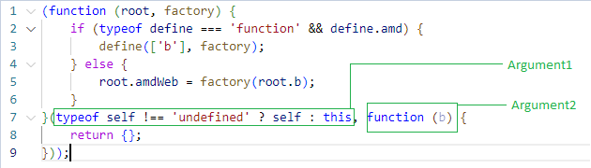
Differences in Java and JavaScript code
Problem: Statements outside of a Function (Script)
Solution: Consider the file body as function body
Code snippet from https://github.com/umdjs/umd/blob/master/templates/amdWeb.js
Notes:
In java we typically write code in a method
However, in JavaScript they can directly be written inside of a file which typically are called script
There are some problems integrating with refactoring miner because it assumes that statements can only be written inside a Method like java
They were matched in a similar fashion as if they were coming from a function body

Slide 13
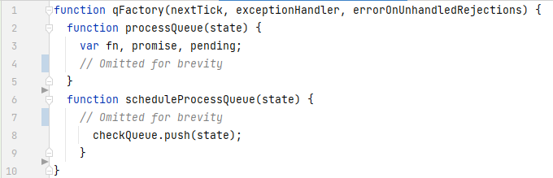
Differences in Java and JavaScript code
Problem: Function Declaration Inside Function Declaration
Solution: Added an additional step that recursively matches the inner function declarations
Notes:
In JavaScript Functions or classes can be declared anywhere and we have found it’s common practice to declare functions inside of a function
This is different than refactoring miner which does not consider that method can have other method declaration
Here the topmost function in line 1 contains only two functions but no other statements.
We matched them recursively and consider them when matching this topmost function.
So, our tool supports potentially unlimited nesting depth which is different from RefactoringMiner which only considers maybe 2-3 level of nesting depth

Slide 14

Differences in Java and JavaScript code
Problem: Function as variable
Solution: If assigned to a simple variable, we consider it as Declaration otherwise it’s a Function Expression
Notes:
Functions are used as variables in JavaScript
Here handle is a variable and at the same time it’s used as a function. Therefore, this line 1 can be treated as a leaf statement or a function declaration
If assigned to a simple identifier like this, we treated it as a function declaration.
Note that it also means we get one less statement to match when comparing with the next version.
Lastly, it might seem like a lambda, however,
Difference between Java lambda is that lambda variable is an object and the interface’s function needs to be invoked
However, in JS, it invokes directly as shown in line 5

Slide 15
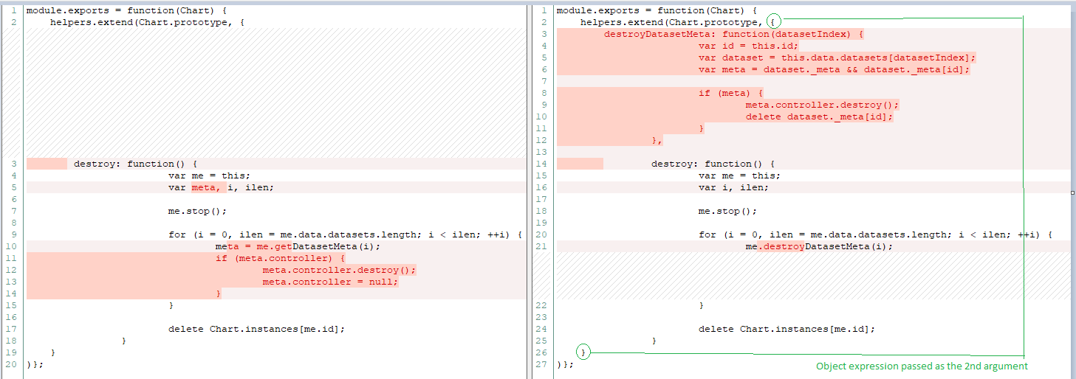
Differences in Java and JavaScript code
Problem: Object Expression
Solution: Treat them as Function Expression
Extract Function destroyDatasetMeta
Notes:
This example shows object expressions which are like java class declaration
1.
In the parser we convert them as Function Declaration / Expression,
Attributes are modeled as statements. Notice the difference in colon for attribute assignment instead of equal sign
2.
As we can see the nesting depth is quite large, for example, the first line is a Function Expression,
then we have another function expression on line 2, helper.extend
lastly this Object as expression is passed as an argument
3.
Here this destroyDatasetMeta method of this object expression is extracted which is not reported by RefDiff 2.0

Slide 16
Differences in Java and JavaScript code
Other differences
- No Static Types (harder to match signatures)
- Function Variable Invocation
- Statement not ending with semicolon
- Self Invoking Function
- Returned Function Invocation
Default value in parameter
Destructuring Assignment
Notes:
- Some of them have limited or partial support
- Some of them such as default value in parameter can be used to improve accuracy in function declaration matching

Slide 17
Evaluation – Research Questions
RQ1: What is the accuracy of JsDiffer in refactoring detection and how does it compare to that of RefDiff 2.0?
RQ2: What is the accuracy of JsDiffer in variable-related refactoring detection?
RQ3: How does the execution time of JsDiffer compare to that of RefDiff 2.0?
Notes:
We evaluated our tool to find out answers to the 3 research questions on how it performs in detection compared to RefDiff 2.0
How it performs on rename variable refactoring detection and lastly the performance

Slide 18
RQ1: Comparison with RefDiff 2.0 - By Types
 | RefactoringType | #Validated | Precision |  | Recall
 |  |  | JsDiffer | RefDiff2.0 | JsDiffer | RefDiff 2.0
1 | EXTRACT_FUNCTION | 65 | 1 | 0.93 | 0.43 | 0.82
2 | EXTRACT_MOVE_FUNCTION | 14 | - | 0.83 | - | 0.38
3 | INLINE_FUNCTION | 10 | 1 | 1 | 0.14 | 0.71
4 | MOVE_CLASS | 1 | 1 | 1 | 1 | 1
5 | MOVE_FILE | 36 | 1 | 1 | 1 | 1
6 | MOVE_FUNCTION | 42 | 1 | 0.97 | 0.3 | 0.94
7 | MOVE_RENAME_FILE | 10 | 1 | 1 | 0.5 | 1
8 | MOVE_RENAME_FUNCTION | 13 | - | 1 | - | 1
9 | RENAME_CLASS | 4 | 0.5 | 1 | 0.33 | 1
10 | RENAME_FILE | 17 | 0.92 | 0.94 | 0.73 | 1
11 | RENAME_FUNCTION | 67 | 0.96 | 0.92 | 0.39 | 0.92
Total |  | 279 | 0.97 | 0.95 | 0.45 | 0.89
Notes:
RefDiff and JsDiffer commonly supports 11 types of refactorings
We ran our tool on 608 commits from popular opensource javaScript project that were also used in the evaluation of RefDiff
We inspected validated 279 refactoring instances and calculated their precision and recall individually
Although JsDiffer achieved a slight better precision of 97% on common types it performs poorly on recall which is only 45% and RefDiff has precision and recall of 95 and 89% respectively
1. JsDiffer reported 10 unique refactorings not reported by refDiff 2.0
1. JSDiffer could not find any EXTRACT_MOVE_FUNCTION or MOVE_RENAME_FUNCTIOn
2. Performed poorly on INLINE_FUNCTIOn
3. Rename class is also poor with it found only 1 third of these refactoring, we inspected

Slide 19
RQ1: Comparison with RefDiff 2.0
Tool | Precision |  | Recall
 | Overall | Common Types | Overall | Common Types
JsDiffer | 0.96 | 0.97 | 0.44 | 0.45
RefDiff 2.0 | 0.86 | 0.95 | 0.9 | 0.89
Precision and Recall on 341 validated refactorings
Notes:
Lastly,
We additionally validated about 80 more refactorings to calculate precision and recall all refactoring types supported by the tool
. We created an oracle of 341 validated refactorings
As you can see JsDiffer performed better in Precision here as well however, it has only half of the recall of RefDiff 2.0
RefDiff’s precision also dropped here but the recall improved slightly
Before ending this slide, We would like to add that
Precision could signify more importance than recall in a refactoring detection tool. Because having a tool with higher precision produces a less noisy result for the end users.
1

Slide 20
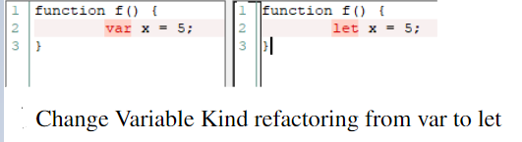
RQ2: Accuracy on Rename Variable
From 608 commits, JsDiffer reported 355 Rename Variable Refactorings
Validated 73 random instances and calculated precision at 88%
Only one Change Variable Kind refactoring was reported which was correct
Notes:
We validated only rename variable as it's one of the most popular refactorings

Slide 21
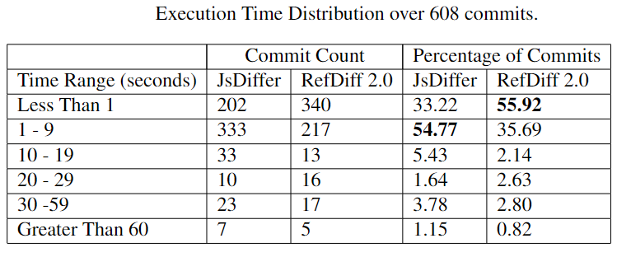
RQ3: Performance
RefDiff 2.0 performed significantly better than JsDiffer
Notes:
Reason is that Lavenshtein Edit distance calculation is significantly frequent and larger than java counterpart

Slide 22
Notes:
Now we are going to discuss the reasons behind poor recall of JsDiffer
We inspected a random sample of 37 refactorings instances which our tool did not report and this pie chart shows the reason. I will focus on the major ones.
The single most major reason of 19% missed refactoring is the subexpression matching.
JavaScript programs written in a Functional way which involves using function as a variable. Therefore, a single or leaf statement or expression often contains multiple function declarations. By RefactoringMiner approach it becomes a huge leaf statement and sometimes the whole program is only a leaf statement. Since our approach cannot go lower than statement level, it has very limited support on matching subexpressions.
2. . Functions can be declared anywhere in JavaSCript, If we generalize all of these moving outside of parent container category, they make up about 37.84% combined
RefactoringMiner assumes that Functions can only be declared directly inside a class therefore this moving outside of parent container is not supported by RefactoringMiner

Slide 23
Limitations
- Function outside of parent container
- Super sets (e.g. TypeScript)
- Class expressions
- Default values of parameters, Destructuring Assignment etc.
Notes:
Now I am going to discuss some of the limitations
-Cannot match invocation with declaration when the Function is extracted outside of the immediate parent container scope
Does not process Super sets (e.g. TypeScript)
Does not go inside class expressions at this moment
Unique JavaScript features are not supported (default values of parameters, Destructuring Assignment etc.)
This is because RefactoringMiner assumes function can only be declared in a Class, Therefore in Java we have some hints where to look for the function. Here it can be anywhere in the nesting depths or another file.
While statements are java are small things, and have smaller nesting depth and complexity, the usage of function in creating scope and usage in variable increased the complexity
Class expressions were not prevalent on the commits that we analyzed

Slide 24
Threats to Validity
1. External
- Small project sample
- Small sample for calculating Precision and Recall, especially for individual refactoring types
- Both tool can miss refactorings
2. Internal
- Biased Oracle
- One Refactoring was reported as multiple or vice versa
Notes:
1. oracle is manually labeled, and human errors might exist
during validation
To mitigate this threat, we have more than
one person to inspect cases in doubt.
2. For example we have only one MoveClass refactoring instance
Lastly, both tool can miss refactoring making it harder to calculate recall
•
•Heavily Inspired by RefactoringMiner’s structural matching approach

Slide 25
Conclusion
- Recommend Hybrid approach utilizing RefDiff’s container matching and Refactoring Miner’s statement matching
- Our approach can be targeted to support other languages written similarity as Java such as C#.
Notes:
1. Finally, Based on our experiments, we recommend that JavaScript projects may need a hybrid approach that combines both RefDiff and RefactoringMiner approaches, where at first, high-level program elements (functions, classes, files) are matched following RefDiff’s approach, and then RefactoringMiner’s statement mapping approach is applied to detect low-level refactorings.
●
2.Lesson learned: We can also target other languages that are written Like Java for example C# With the hybrid approach. RefactoringMiner was designed having the typical Java program structure in mind therefore it is expected to perform better on programs written in similar fashion of Java

Slide 26
Thank You

